Slide 1

Notes:
1st slide (Mandatory)

Slide 2
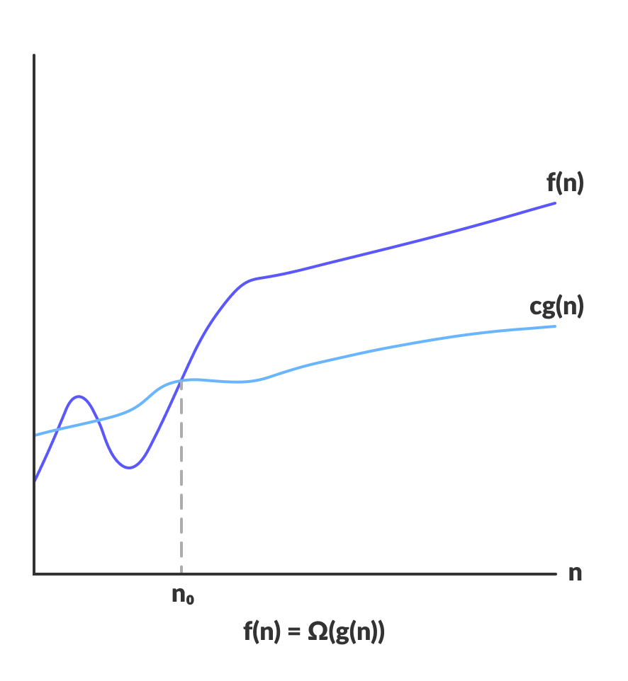

Space Complexity
f(n)
cg(n)
O (n^2)
n₀

Slide 3
Calculate Space Complexity
How To
O(n^2)
Operations
O (n log n)
O (n^2)
O(n)
Elements

Slide 4

What is Space Complexity?
Topic/Course
Space Complexity of an algorithm is the total space taken by the algorithm with respect to the input size.
Space complexity includes both Auxiliary space and space used by input.
Auxiliary Space is the extra space or temporary space used by an algorithm.
Space complexity is a parallel concept to time complexity. If we need to create an array of size n, this will require O(n) space. If we create a two-dimensional array of size n*n, this will require O(n²) space.
Notes:
Space complexity refers to the amount of memory space required by an algorithm to execute and solve a problem. It is usually expressed in terms of the number of memory storage locations required to hold the program code, input data, output data, and any auxiliary data structures created during the execution of the algorithm.
The space complexity of an algorithm can be affected by several factors, such as the size of the input data, the number and size of auxiliary data structures used, and the way memory is allocated and deallocated during the execution of the algorithm.
Space complexity is an important aspect to consider when analyzing and comparing different algorithms because it can have a significant impact on the performance and scalability of the algorithm. In some cases, an algorithm with lower time complexity may require more memory space, which can make it less efficient and less practical for certain applications.

Slide 5
Predict the space complexity for the given below code snippet
int add (int n)
{
if (n <= 0)
{
return 0;
}
return n + add (n-1);
}
A) O(1)
B) O(n)
C) O (n * log n)
D) O(n * n)
Notes:
B) O(n)
The space complexity of the given code snippet is O(n), where n is the input to the function.
This is because each function call requires space to store its local variables and function call information, which is added to the stack memory. In this case, the function is called recursively n times, so the maximum space used in the stack is proportional to n.
Therefore, the space complexity is directly proportional to the size of the input, making it a linear space complexity.

Slide 6
Predict the space complexity for the given below code snippet
int addSequence (int n)
{
int sum = 0;
for(int i = 0; i < n; i++){
sum += pairSum(i, i+1);
}
return sum;
}
int pairSum(int x, int y){
return x + y;
}
A) O(1)
B) O(n)
C) O (n * log n)
D) O(n * n)
Notes:
O(1)
The space complexity of the given code snippet is O(1) because it only uses a fixed amount of memory space to store the variable "sum" and the loop variable "i". The function "pairSum" also uses a constant amount of memory to store its two parameters and its local variable. Therefore, the space complexity does not depend on the input size n.

Slide 7
Predict the space complexity for the given below code snippet
int foo(int n) {
int* arr = new int[n];
for (int i = 0; i < n; i++) {
arr[i] = i;
}
return arr[n-1];
}
A) O(1)
B) O(n)
C) O (n * log n)
D) O(n * n)
Notes:
b) O(n)
This function foo takes an integer n as input and creates a dynamic array of size n using the new keyword. It then fills the array with integers from 0 to n-1, and returns the value at index n-1.
To calculate the space complexity of this function, we need to look at the amount of memory used in relation to the input size n. In this case, the function allocates an array of size n, which requires n * sizeof(int) bytes of memory. This is a linear relationship between the input size and the amount of memory used, so we can express the space complexity of this function as O(n).
Note that we also need to take into account any additional memory used by the function beyond the size of the input. In this case, the function uses a constant amount of extra memory to store the integer variable i, so we can ignore this when calculating the space complexity.

Slide 8
Predict the space complexity for the given below code snippet
int sum = 0;
for (int i = 0; i < n; i++) {
sum += i;
}
A) O(1)
B) O(n)
C) O (n * log n)
D) O(n * n)
Notes:
b) O(1)
Space complexity: O(1) - the space used by this code snippet does not depend on the input size n. The only variable declared is sum, which uses a constant amount of space regardless of the value of n.

Slide 9
Predict the space complexity for the given below code snippet
int fibonacci(int n) {
if (n <= 1) {
return n;
}
return fibonacci(n-1) + fibonacci(n-2);
}
A) O(1)
B) O(n)
C) O (n * log n)
D) O(n * n)
Notes:
b) O(n)
Space complexity: O(n) - the space used by this function grows linearly with the input size n. Each recursive call to fibonacci creates a new stack frame, which adds to the space used. As the depth of the recursion tree is proportional to n, the overall space complexity is O(n).

Slide 10
Predict the space complexity for the given below code snippet
struct Node {
int data;
Node* next;
};
Node* head = nullptr;
void insert(int data) {
Node* newNode = new Node();
newNode->data = data;
newNode->next = head;
head = newNode;
}
A) O(1)
B) O(n)
C) O (n * log n)
D) O(n * n)
Notes:
b) O(n)
Space complexity: O(n) - the space used by this data structure grows with the number of elements stored. Each call to insert creates a new Node object and adds it to the linked list, which increases the space used by a constant amount. As the linked list can grow up to n elements, the overall space complexity is O(n).

Slide 11

THANK YOU

